Slide 1

SASS
A CSS Preprocessor

Slide 2
Have you ever been wondering?
CSS is a programming language right so..
Where are the following:
Loops? Variables? Nested statements? If else? etc.?

Slide 3
Because CSS is a DSL
DSL or Domain Specific Language means it was made for a specific purpose – to add styling to your HTML pages
The Syntax? So Simple? Because it’s a Declarative language – this means that the logic behind the styling is not described.
Ex.
CSS
.child { background: black; } //this styles every element with a class name child.
In the background this uses a loop, but the burden of specifying it is removed from our responsibility.

Slide 4
Disadvantages of styling with plain CSS
Hierarchical problem
Repeated stylings

Slide 5
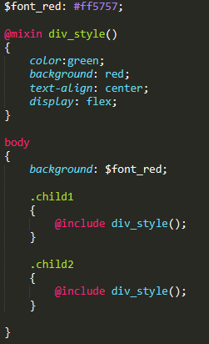
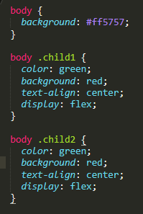
Solution?
To use a preprocessor
SASS
CSS

Slide 6
Software used in using SASS?
Scout-App
See more

